Slide 1

High-Side Current Sensor Using a Shunt Resistor for Electric Vehicle Battery Monitoring Systems
Dinujaya Thamara -EC/2021/005
BECS 22451

Slide 2
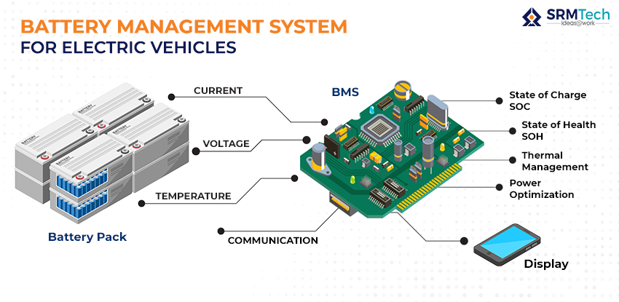
How It Works
CORE CONCEPT
A high-side current sensor is placed on the positive terminal of the battery. It uses a shunt resistor to measure the voltage drop caused by the current flowing through it. This voltage drop is proportional to the current, allowing us to monitor the battery's performance.
Key Features
Monitors charging and discharging currents.
Ensures safety by detecting overcurrent conditions.
Provides real-time data for BMS.

Slide 3
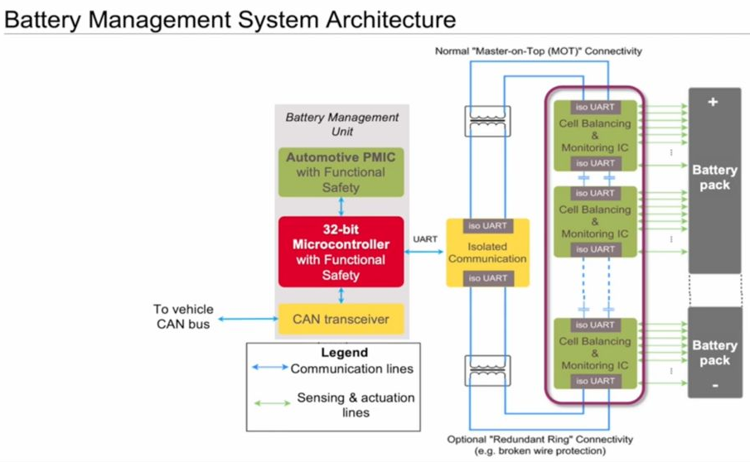
Real-World Application
Application in EVs
In electric vehicles, high-side current sensors ensure the battery operates within safe limits. They help optimize energy usage, extend battery life, and prevent hazardous situations like overheating or short circuits.
Advantages of high-side placement
Measures both load and charging currents.
Protects sensitive circuits by avoiding a direct ground reference.
Ensures system-wide safety and reliability.

Slide 4
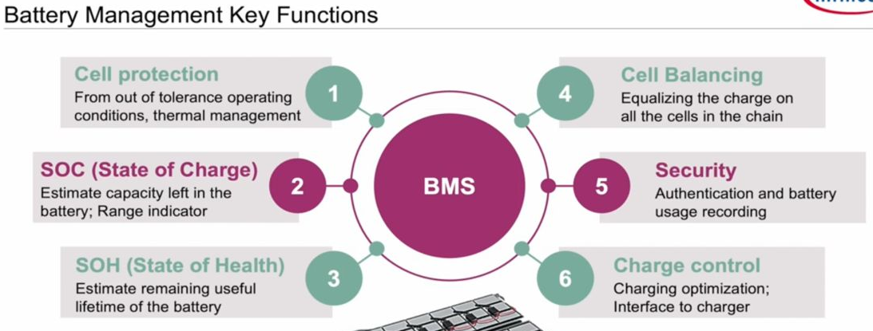
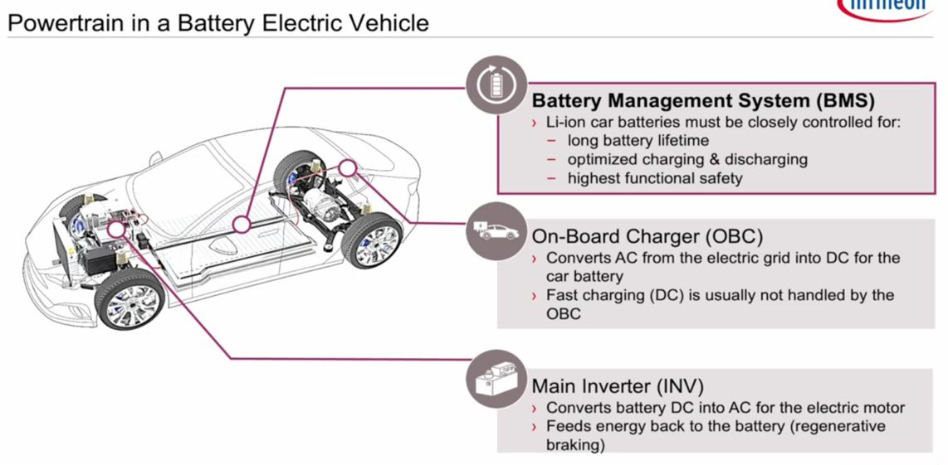

Slide 5
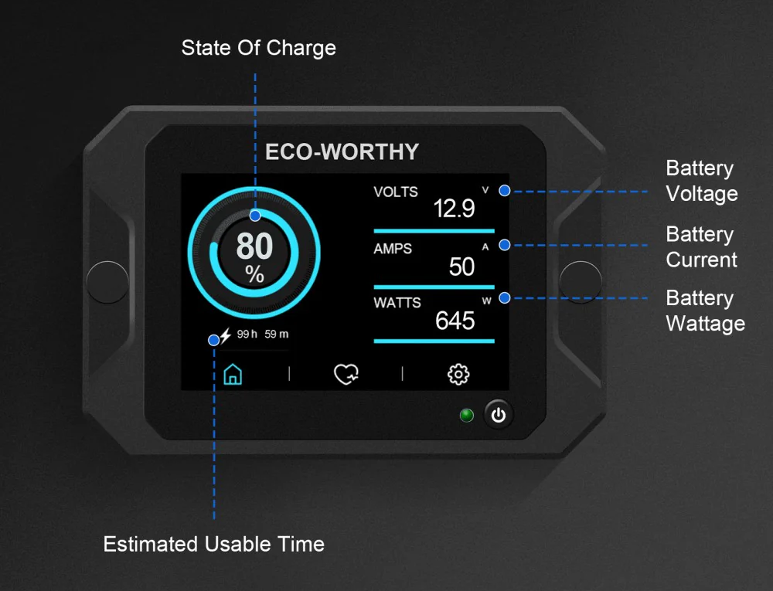
Thank You

